Slide 1



HACK MATRIX HACKATHON
TITLE PAGE
2ND ARPRIL, 2026
PROJECT TITLE :
SMART NOTES AI-HANDWRITTEN TO DIGITAL CONVERTER
TEAM NAME :
CodeNova
TEAM MEMBERS :
GAURI CHAUDHARY ( 25BAI10976)
SAMRIDDHI KESARWANI (25BAI10185)
ANSHIKA AGNIHOTRI (25BAI10981)
AKSHARA KHANDELWAL (25BAI10408)

Slide 2

PROBLEM STATEMENT
Handwritten notes are not searchable or editable.
Manual typing is time consuming.
Existing tools give unstructured and inaccurate output.
Important information gets lost in notebooks.
Describe the problem clearly .
Who is affected by this problem ?
Students
Teachers
Researchers
Competitive Exams Aspirants
Why this problem is important ?
Efficient Learning needs structured and searchable notes.
No integration with modern study tools.
Limited productivity in a fast digital learning environment.
Lack of structured formatting.

Slide 3
EXISTING SOLUTIONS AND GAPS
Google Lens
Basic Optical Character Recognition (OCR ) Apps
Scanning Apps ( Adobe Scan)
(Provide quick Digitization but limited intelligence)
List of existing Solutions (if any)
Poor Accuracy for messy handwriting.
No proper Formatting (Tables , Heading , Diagrams , etc)
No smart summaries or key point extraction .
Often requires switching between multiple apps
Requires manual editing after conversion
Mention their Limitations
Explain the gap your project will address
Accurate Handwritten text recognition + Smart formatting together.
Structured output ( Headings, Tables , Diagrams , Bullet Points…)
Integration of OCR + AI + Learning tools
Easy editing in one place.
Word Meaning / Concept explanation support.

Slide 4
PROPOSED SOLUTION
Explain your solution clearly
AI Powered app to convert Handwritten notes into Structured editable and smart digital content
Accurate text extraction.
Customizable / Auto formatting.
Bullet points summaries ( Headings, subheadings, Tables , Diagrams…)
Flashcards and Keywords highlight.
Word meaning and smart suggestions.
Export Options (PDF , PPT, JPEG, ..)
List key features
Explain how it solves the problem
notes to Digital text → makes content searchable → add headings and structures → generates Key points and summary → creates Flashcards → easy to store and share → customizable Smart AI-Based outputs
“ Turns handwritten notes into Smart study material ”

Slide 5
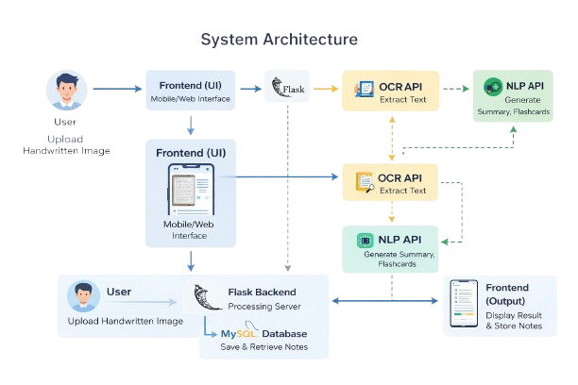
SYSTEM ARCHITECTURE
Include architecture diagram
Mention main components (Frontend, Backend, Database, APIs)
Explain data flow briefly
User → Frontend (HTML/CSS/JS) → Backend (Python Flask) → AI Processing → Database → Final Output
BACKENED :
Python Flask
FRONTENED :
Mobile / Web UI (UI for viewing, uploading & editing notes)
Database:
MySQL
APIs
OCR - Extract Text from Handwritten images.
NLP – Generates summaries , Creates flashcards , Extract meanings.

Slide 6
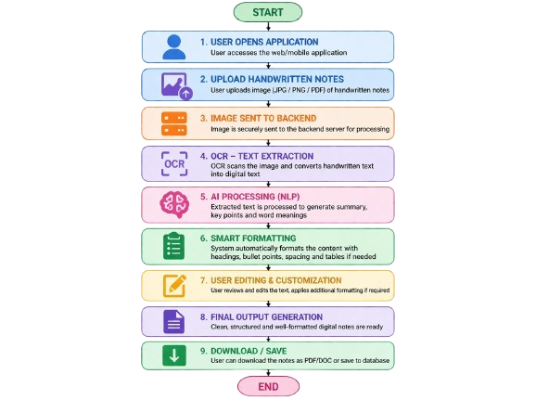
FLOWCHART / WORKING PROCESS
Show step-by-step working
Include user flow or system flow
Use a proper flowchart
Step 1 : User uploads Handwritten image .
Step 2 : Image pre-processing.
Step 3 : Text extraction (OCR).
Step 4 : NLP processes content .
Step 5 : Features applied ( Headings, Tables , Key points , Summaries , Diagrams).
Step 6 : Final output displayed .
Step 7 : Manual customization (If any)
Step 8 : Export / Download .
Upload Handwritten notes.
Capture images via camera.
Select image from gallery.
Do customization (if any).
View final output .
Save/ Download notes.

Slide 7
TECH STACK
Frontend technologies
HTML , CSS , JavaScript
(UI to upload , added & view results )
Tools and APIs used and reason for choosing each (1 line each)
OCR : Google Vision
( Text Extraction from Handwritten notes )
NLP: OpenAI
( Summary , Key points , Word meanings )
Backend technologies
Python (Flask)
(Processes data and manages application logics)
Database
MySQL
(Store notes and User data )

Slide 8
IMPLEMENTATION PLAN
Step 1 : UI design
Step 2 : OCR Integration
Step 3 : Feature Integration (NLP)
Step 4 : Implement formatting tools Step 5 : Connect MySQL Database
Step 6 : Testing & Optimization
Step-by-step development plan
Modules or features to be built
User Interface Module → Image upload & display
OCR Module → Extract text from handwritten notes
NLP Module → Summary, key points, word meanings
Formatting Module → Headings, bullets, structure
Database Module → Store notes and user data
Timeline (if applicable)
Day 1: UI + Upload
Day 2: OCR
Day 3: NLP + Formatting
Day 4: Database + Testing

Slide 9
EXPECTED OUTCOME / IMPACT
Expected results of the project
Accurate text extraction
Proper structured notes
Smart summaries and flashcards
Intelligent output with auto-formatting
Benefits to users
Easy digital storage
Saves time and effort
Easy to edit, search, and organize notes
Better revision with summaries & flashcards
All-in-one solution (no need for multiple apps)
Real-world impact
Reduces paper dependency
Helps students and teachers in digital learning
Smart education
Enhances productivity in daily tasks

Slide 10
FUTURE SCOPE AND CONCLUSION
Support for multiple languages (regional & global) .
Add voice notes conversion .
Cloud sync for access across devices .
AI-based learning assistance .
Future improvements
Enhances both productivity and learning experience.
Bridges the gap between handwritten and digital notes .
Combines OCR + AI + Formatting into one powerful solution .
Makes note-taking smarter, faster, and more efficient .
Supports the transition towards smart and digital education .
Final summary
Scalability of the project
Integration with learning platforms and educational tools .
Adaptable for schools, colleges, and organizations worldwide .
Expand AI features (advanced summaries, insights) .
Improve processing speed .
Scale backend with demand .

